Slide 1
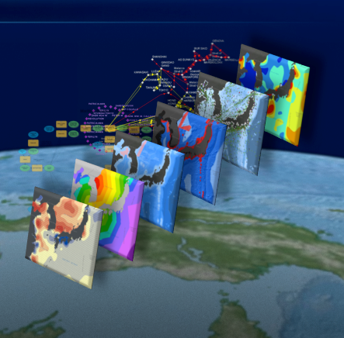

Final Project
December 8th, 2014
Threshold Analysis for Stream Networks Extraction from Digital Elevation Model
Mehran Ghandehari
Jennifer Bloom
Brent Seiferd
William Smith
Geography Department

Slide 2
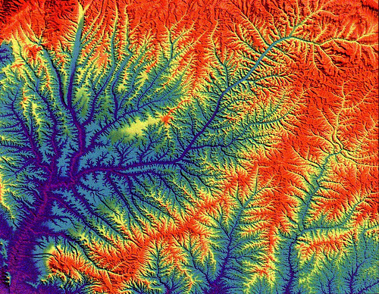


Introduction
Stream Network Extraction from Digital Elevation Model
Notes:
Digital Elevation Models (DEMs) are widely used in stream network extraction and numerous techniques have been proposed to extract the stream network from DEM
In these techniques it is assumed that water always flows along the path of steepest descent, and infact the flow of water is simulated to delineate stream networks.

Slide 3
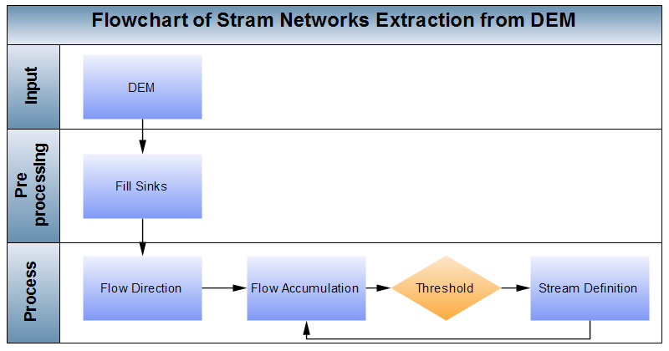
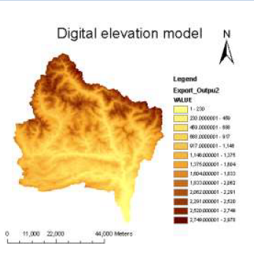
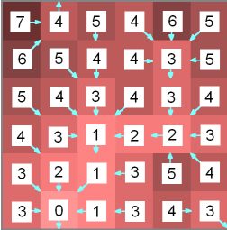
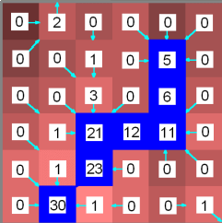
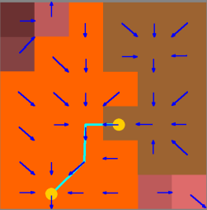
Introduction
Stream Network Extraction from Digital Elevation Model
Notes:
This figure illustrates one of the most common way for stream network extraction from raster DEM that you are completely familiar with.
For stream definition a threshold for flow accumulation is defined; all cells in the flow accumulation matrix with a value greater than the threshold are defined as a stream cell
A lower threshold value results in a denser stream network.

Slide 4
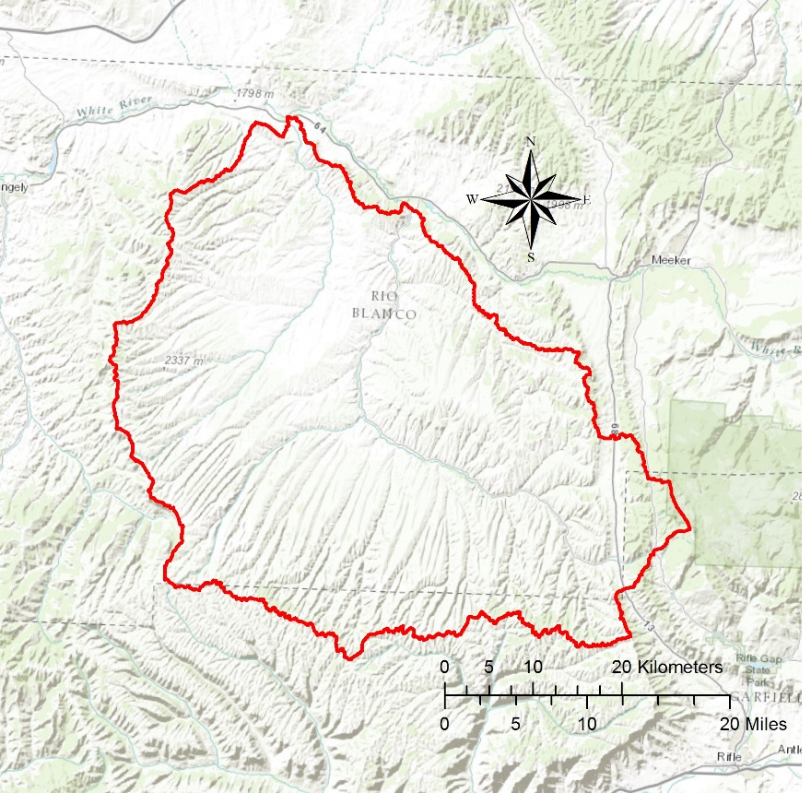
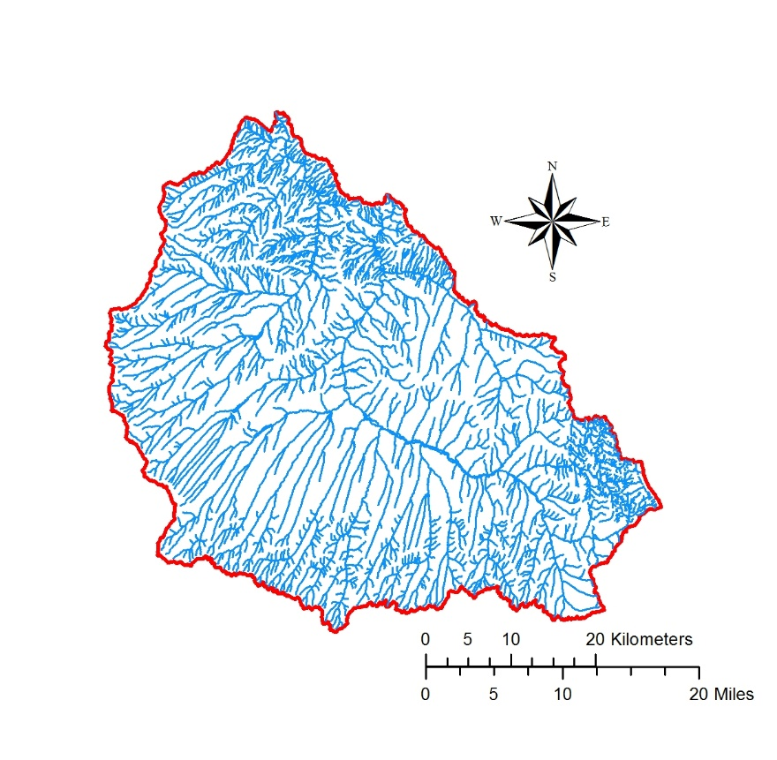
Introduction
Threshold
Topographic map
Available benchmarks (e.g., NHD)
Notes:
The most common way to determine a stream threshold is trial and error by visual comparison of the networks generated with ancillary datasets such as topographic maps or available benchmark datasets .
This procedure is so time consuming, and is considered one of the main challenges of stream network extraction.

Slide 5
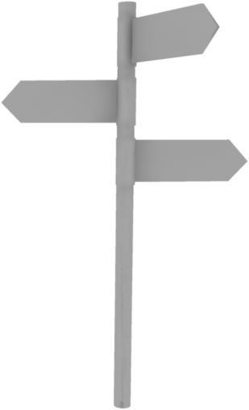


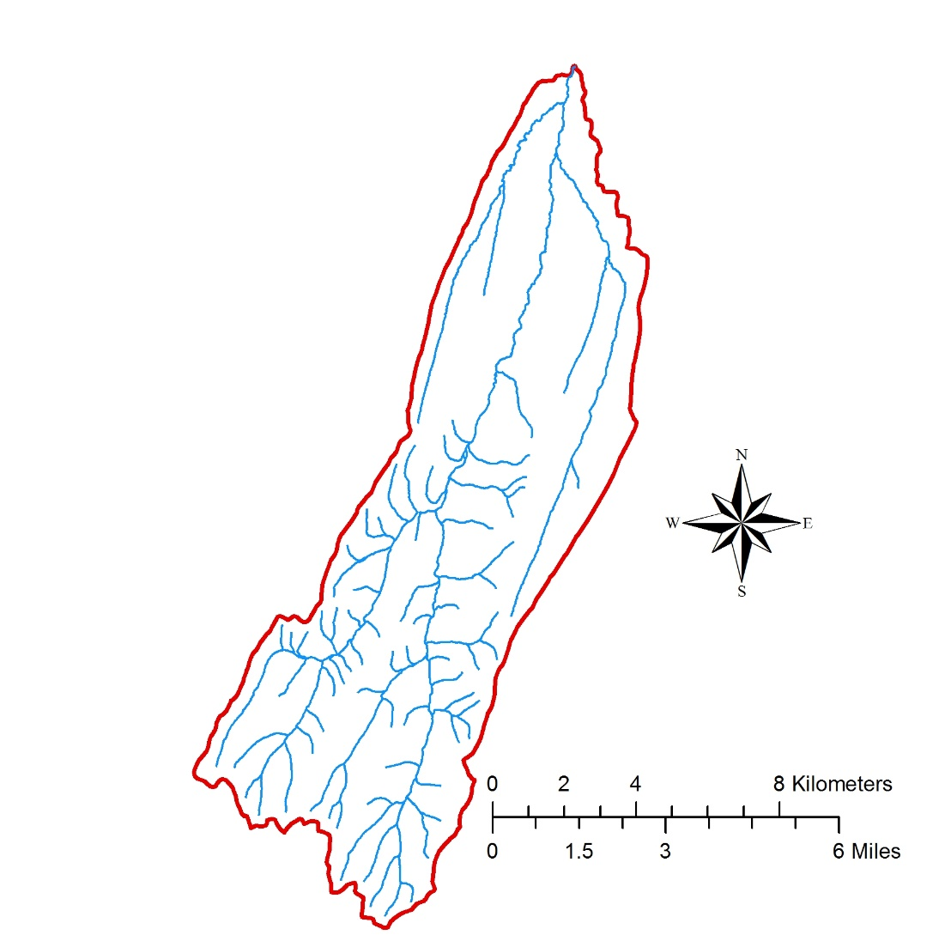
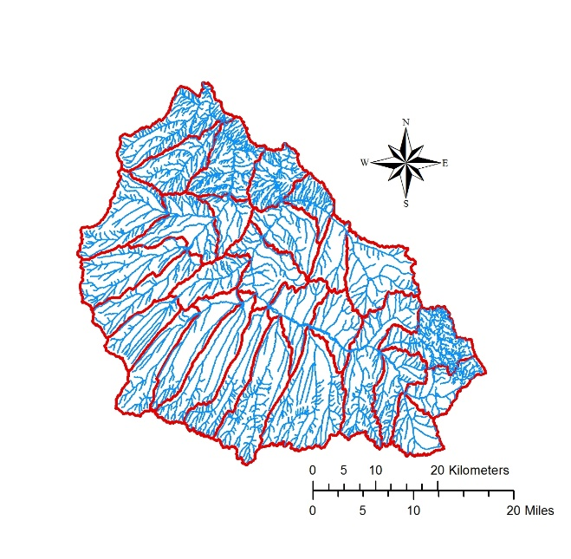
Introduction
Threshold
Notes:
we made an automated workflow for finding the best threshold and We Started with the smallest hydrological unit
Although this model ran successfully, but we found that the final extracted stream networks were not accurate. We found that using one single threshold for extracting stream networks for an input DEM leads to inaccurate results due to disparities in density, and this issue is more serious for larger hydrological units.
And here a challenging debate started and finally we came up with a great solution.

Slide 6
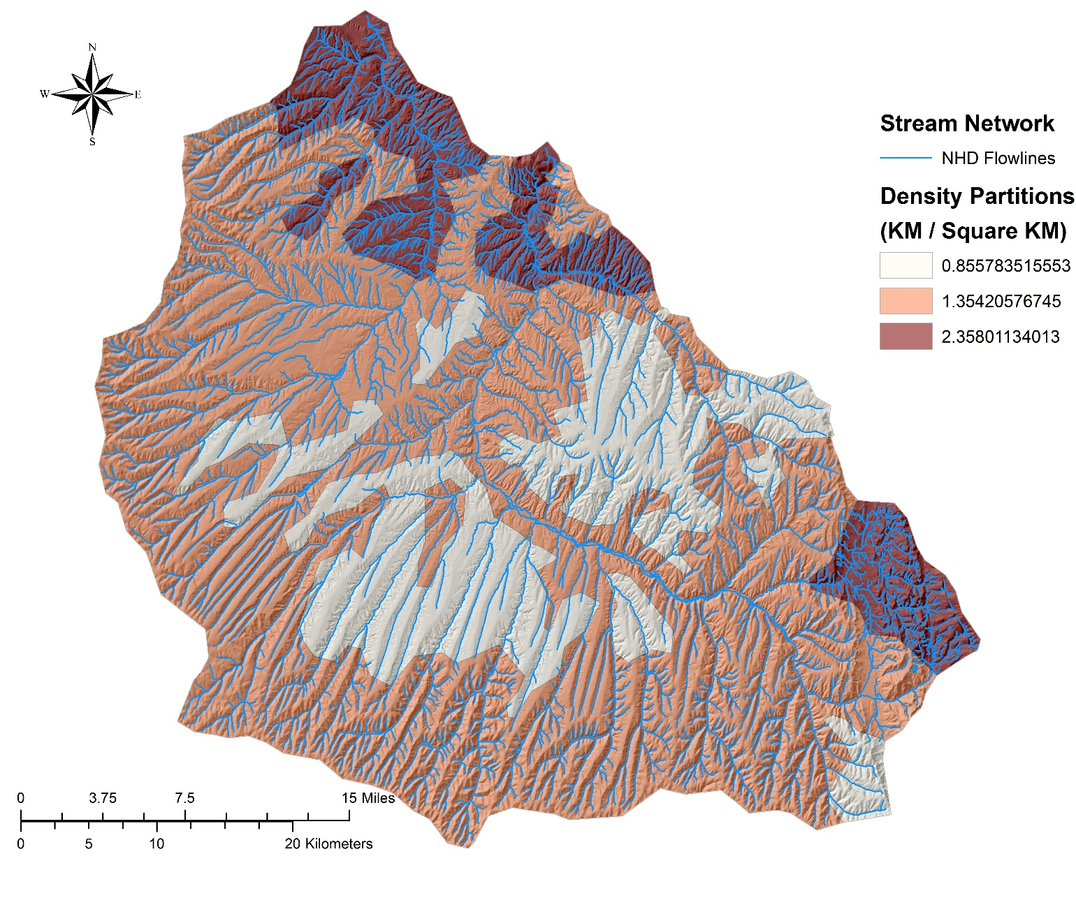

Introduction
Density partitions
Notes:
We use the density partitions for finding the best threshold and extracting streams. As you can see it is reasonable to use one threshold for each density partition

Slide 7
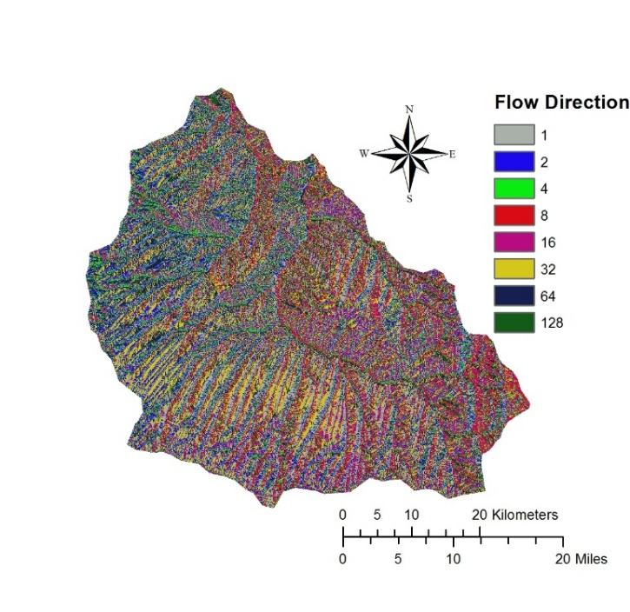
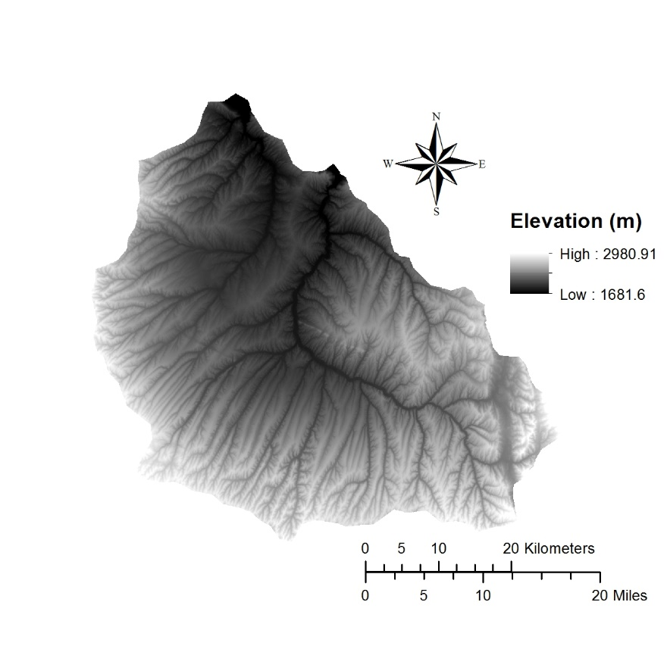
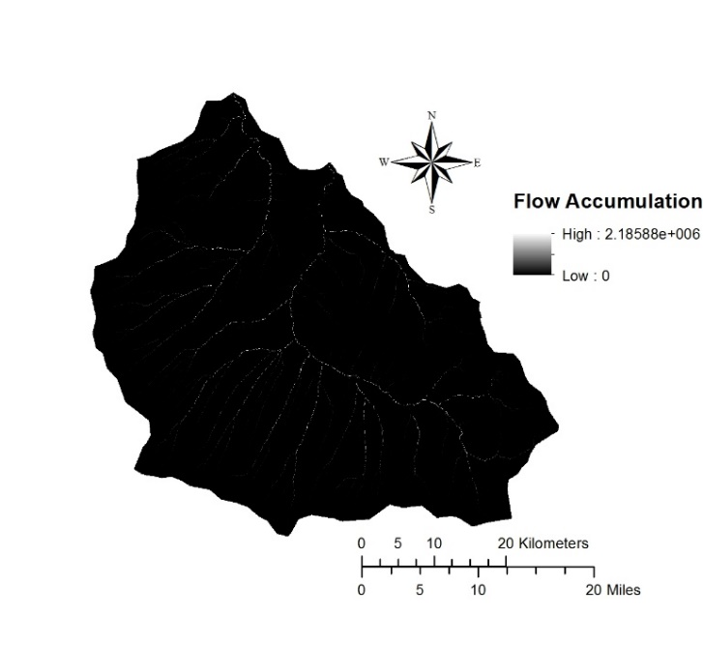
Proposed Method
Step 1
Notes:
Step 1: DEM 30 created stream network
*first model does Flow accumulation and Flow direction for the whole study area

Slide 8
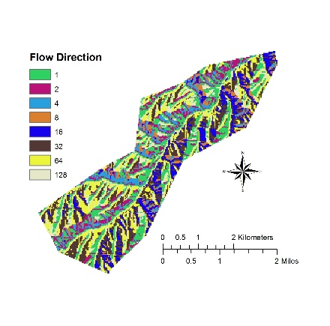

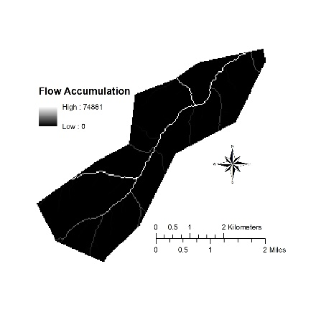
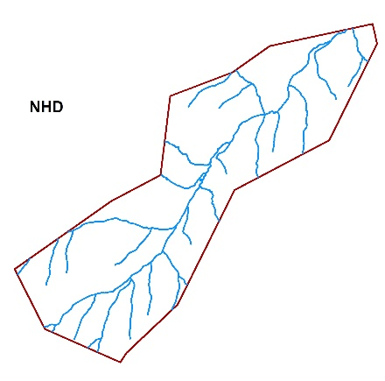
Proposed Method
Step 2
Notes:
Then the flow accumulation and flow direction of study area broken into density partitions, and for each one the process of stream network extraction is done

Slide 9
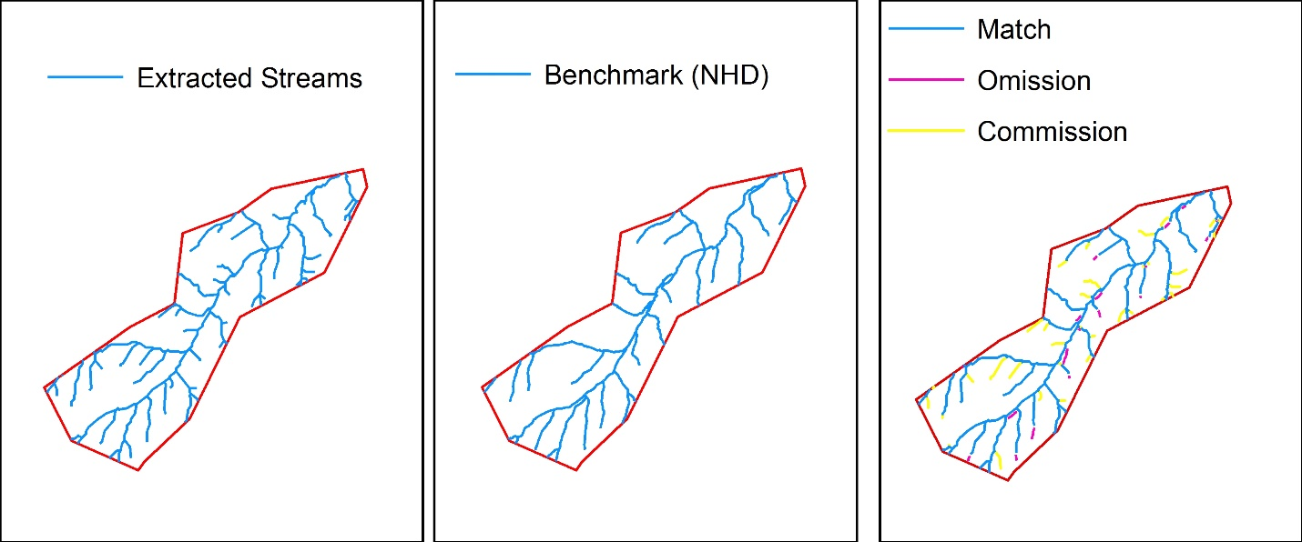
Proposed Method
Step 3:Validation (Coefficient of Line Correspondence )
$$\frac{lengths of corresponding features}{\left.\left(lengths of corresponding features\right)+(length of commission errors + length of omission errors\right)}$$
Notes:
Coefficient of Line Correspondence (CLC) is how well the created network matches the benchmark NHD data
Result is between 0-1. A result of 0.6 or more is considered a fair match.
Created stream is considered the “same” if it falls within a 40 m buffer of the benchmark
Omission= streams which exist in the benchmark but not in created data
Commission = streams which exist in the created data but not in the benchmark
/// As Model iterates, it’s constantly looking for highest possible CLC in each run.
CLC algorithm computes the conflation between the stream network generated from the DEM and the National Hydrological Dataset (NHD). Conflation occurs when the dissimilarity between two different objects appears to be lost, such as when a DEM-derived stream network and the NHD stream network appear as one visually on a map. When the two datasets do not match up, this is the result of comissions or omissions. Omissions occur when DEM-derived stream length is less than the benchmark NHD stream network; comissions occur when DEM-derived stream length is greater than the NHD stream network.

Slide 10
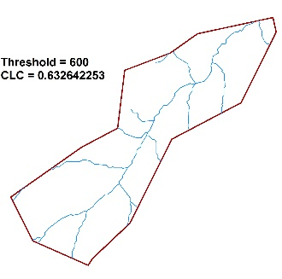
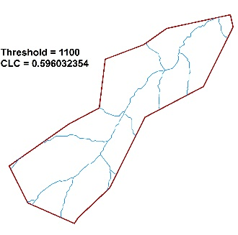
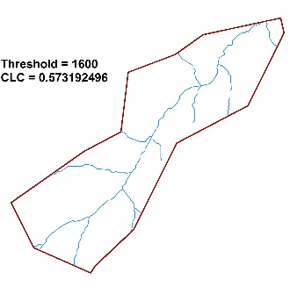

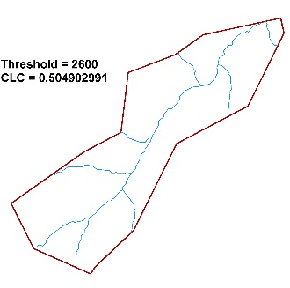
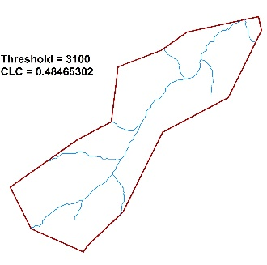
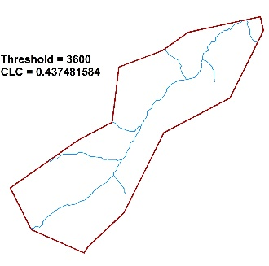
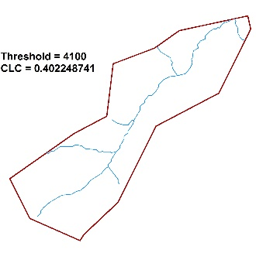

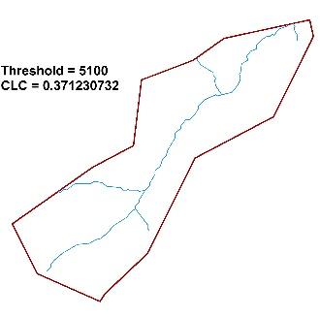
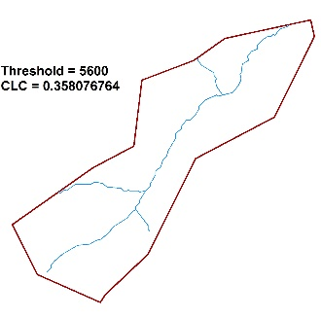
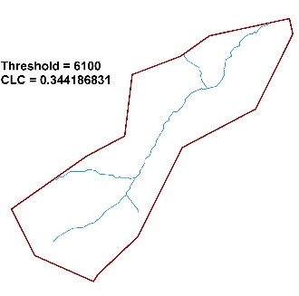
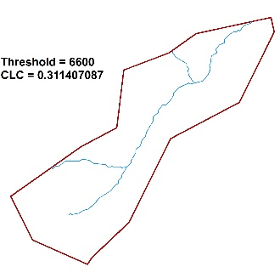
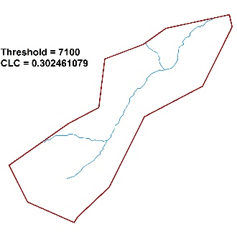




Proposed Method
Step 3 (First loop)
Notes:
1st loop: Threshold value is set between 500 – 10000
skip by 500
Groups of 500. If threshold set very high, we get basic stream networks
If set low, we get too much complexity in our stream networks.
We’re looking for the sweet spot where conflation occurs between DEM-derived stream network and NHD data; where omissions and commissions are as close to zero as possible, and the CLC is as close to 1 as possible.
//This is how the models work:
Points in graph correspond to all the threshold values run, and their CLC values.
In the end, looks at what the highest CLC value is for each of the thresholds tested, and will use this highest value to compute the next loop.

Slide 11
Proposed Method
Step 3 (First loop)
Notes:
Model finds out which threshold value results in the highest CLC
In this instance, errors are almost all being introduced by omission

Slide 12
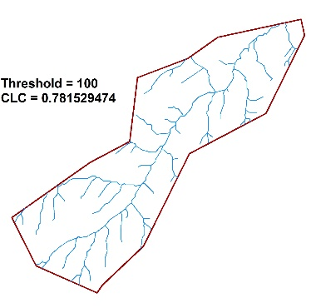
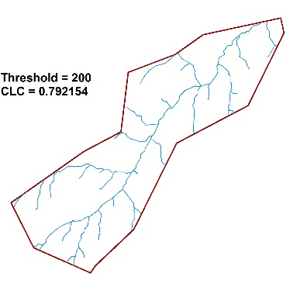
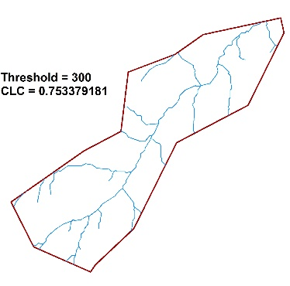
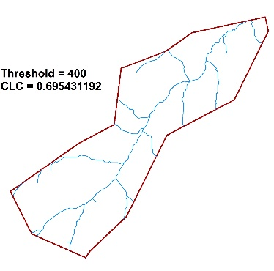
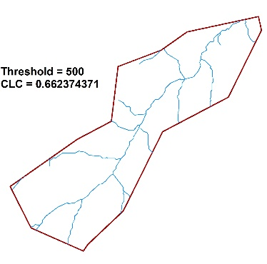
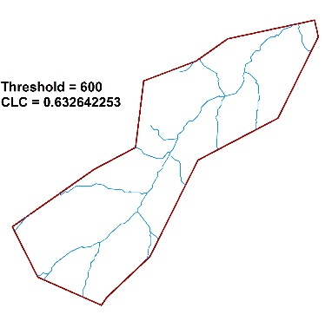

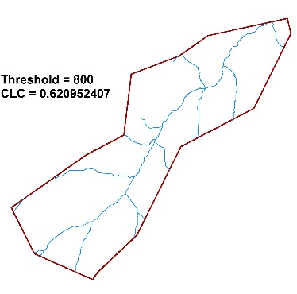
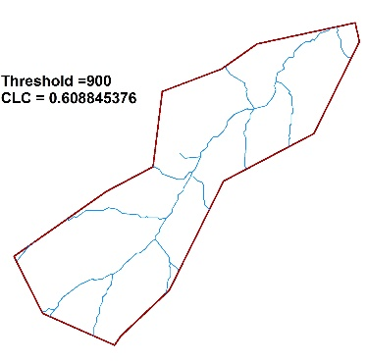
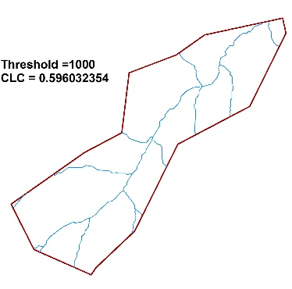
Proposed Method
Step 3 (Second loop)
Notes:
Second loop looks at the value of the first and goes +/- 500 by intervals of 100.

Slide 13
Proposed Method
Step 3 (Second loop)
Notes:
Once again, highest CLC values is chosen
in this case, a threshold value of 100 was introducing commission errors compared to the benchmark data.
//
To the left of the peak, commissions are occurring, streams are being introduced: commission errors dominant
To the right of the peak, omissions are occurring, streams are being introduced: omission error dominant
Positive slope indicates commission errors – getting less accurate as streams are added
Negative slope indicates omission errors – getting less accurate as streams removed

Slide 14
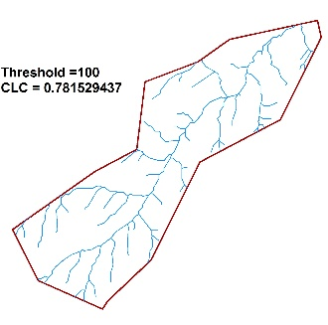
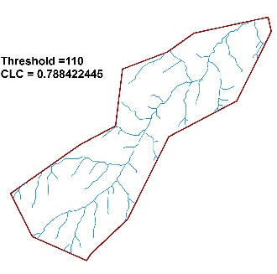
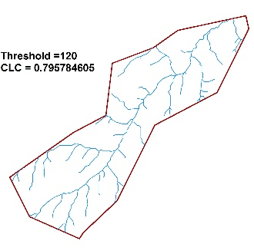

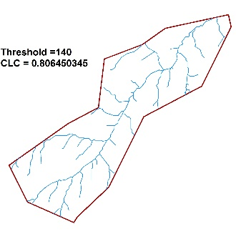
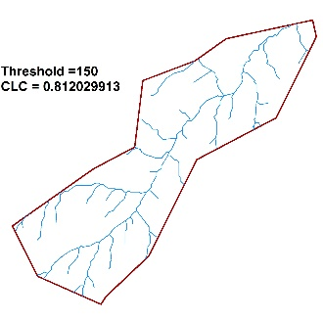
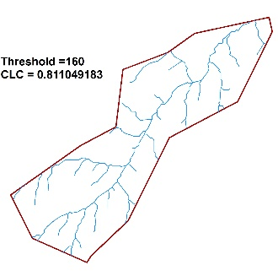

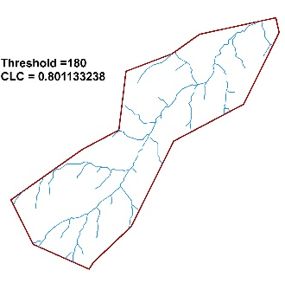
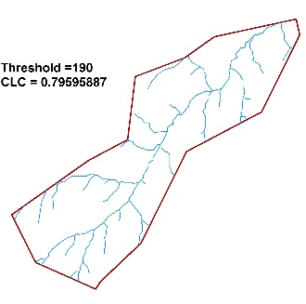

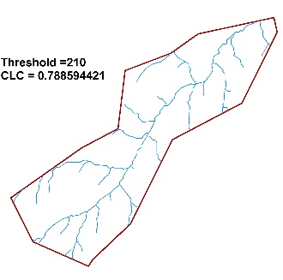






Proposed Method
Step 3 (Third loop)
Notes:
Take second value and go +/- 100 by 10.

Slide 15
Proposed Method
Step 3 (Third loop)
Notes:
Highest CLC value is the final result for the area.
Peak indicates the best fir threshold for this given region of interest.
To the left of the peak, commissions are occurring, streams are being introduced: commission errors dominant
To the right of the peak, omissions are occurring, streams are being introduced: omission error dominant
Positive slope indicates commission errors – getting less accurate as streams are added
Negative slope indicates omission errors – getting less accurate as streams removed

Slide 16






Datasets
NED – National Elevation Data
DEM – Digital Elevation Model
30 m
NHD – National Hydrographic Data
Stream Networks
24K
WBD – Watershed Boundary Data
HU(C) – Hydrologic Unit (Code)
Huc8 & Huc12
Density Partitions
Thanks Babs et. al.
Notes:
Brief Description of the data.
Clarity brought to the the delineation of HU’s and HU(C) for class benefit
Which data comes from where

Slide 17


Study Areas
Notes:
To properly test our model, different subbasins were tested to generate results in heterogeneous subbasins with diverse landscape differences.
To calculate the best threshold for these HUC8 subbasins, the model was based on density partitions of these regions of interest.

Slide 18




Study Areas
Notes:
You should talk about different landscape type (Hilly Humid, Hilly Dry, Mountainous Humid, Mountainous Dry)

Slide 19

Evaluation and Results
Pomme de Terre, Missouri
 | CLC | Threshold | Elevation | Slope
Max | 0.4737 | 70
Min | 0.9584 | 680
Mean | 0.6741 | 276 | 322.06 | 7.04%
STD | 0.1535 | 191 | 48.6 | 6.18
Notes:
Please note that the threshold is the number that was used to generate stream networks, the tables show the average for the group the total area covered and the percentage of streams successfully generated with the requisite threshold when compared to the NHD standard.
Draw you attention to the orange table and results. Notice the large area covered by only two thresholds and the rather underwhelming success rate. Why is that? Next Slide

Slide 20
Evaluation and Results
Pomme de Terre, Missouri
 | CLC | Threshold | Elevation | Slope
Max | 0.4737 | 70
Min | 0.9584 | 680
Mean | 0.6741 | 276 | 322.06 | 7.04%
STD | 0.1535 | 191 | 48.6 | 6.18
Notes:
Please note that the threshold is the number that was used to generate stream networks, the tables show the average for the group the total area covered and the percentage of streams successfully generated with the requisite threshold when compared to the NHD standard.
Draw you attention to the orange table and results. Notice the large area covered by only two thresholds and the rather underwhelming success rate. Why is that? Next Slide

Slide 21

Evaluation and Results
Pomme de Terre, Missouri
Notes:
Please note that the threshold is the number that was used to generate stream networks, the tables show the average for the group the total area covered and the percentage of streams successfully generated with the requisite threshold when compared to the NHD standard.
Draw you attention to the orange table and results. Notice the large area covered by only two thresholds and the rather underwhelming success rate. Why is that? Next Slide

Slide 22

Evaluation and Results
Pomme de Terre, Missouri
Notes:
Please note that the threshold is the number that was used to generate stream networks, the tables show the average for the group the total area covered and the percentage of streams successfully generated with the requisite threshold when compared to the NHD standard.
Draw you attention to the orange table and results. Notice the large area covered by only two thresholds and the rather underwhelming success rate. Why is that? Next Slide

Slide 23





Evaluation and Results
Piceance and Yellow Creek Colorado
Extracted
Extracted
NHD
NHD
 | CLC | Threshold | Elevation | Slope
Max | 0.9488 | 1610
Min | 0.5362 | 60
Mean | 0.7387 | 555 | 2202.57 | 26.73%
STD | 0.0983 | 501 | 209.17 | 20.29
Notes:
Here you should talk about the reason of low CLC in those two density partitions
In the left: because it is a small partition and only one river flow through the partition, an small error can decrease the accuracy significantly
In the wright: it is only contain the first order streams and in the NHD data a lot of first order streams had been elliminated

Slide 24

Evaluation and Results
South Branch Potomac, West Virginia
Notes:
There is not any Correlation between Threshold and CLC
There seems to be a relationship between Density and CLC.; Areas with higher density had higher CLC.
there is a correlation between threshold and density. As you can see, the points are clustered into groups corresponding to the density partitions. This suggests that the best fit threshold is related to density and that subbasins with the higher densities also possess the lowest threshold values.

Slide 25

Evaluation and Results
Lower Prairie Dog Town Fork Red River, Texas
 | CLC | Threshold | Elevation | Slope
Min | 0.1772 | 0
Max | 0.8330 | 5590
Mean | 0.5651 | 763 | 630.24 | 5.83%
STD | 0.1856 | 1424 | 90.12 | 7.92

Slide 26


Evaluation and Results
Lower Prairie Dog Town Fork Red River, Texas
NHD
 | CLC | Threshold | Elevation | Slope
Min | 0.1772 | 0
Max | 0.8330 | 5590
Mean | 0.5651 | 763 | 630.24 | 5.83
STD | 0.1856 | 1424 | 90.12 | 7.92
Extracted
Notes:
You should refer to the problems that happen for extracting streams from DEM
Flow goes underground in reality
Flow Direction/Accumulation tools expect flow to be continuous over surface
Mean slope is just over 1 degree
That id why texas has the lowest CLC

Slide 27

Evaluation and Results
Lower Prairie Dog Town Fork Red River, Texas
CLC < 0.3
NHD
 | CLC | Threshold | Elevation | Slope
Min | 0.1772 | 0
Max | 0.8330 | 5590
Mean | 0.5651 | 763 | 630.24 | 5.83
STD | 0.1856 | 1424 | 90.12 | 7.92
Extracted

Slide 28

Evaluation and Results
…
Notes:
Because of time limitation we cannot go further through evaluation

Slide 29
Conclusions
Choosing one threshold for extracting streams from DEM leads to inaccurate results
Using density partitions for extracting streams from DEM improves the results
There is a correlation between threshold and CLC and also between threshold and density
Some of the small CLC values are related to DEM-based method problems (e.g., flat areas, water bodies), and some of them are related to the definition of density partitions that more investigation is required
Most of the errors is extracted streams were related to the first order streams
Some stream disconnectivity happen due to the clipping of raster data

Slide 30



Acknowledgments
XXX
Notes:
Brent Speaking!!
Thank you babs for helping us find direction in our project and your years of effort in the field that clarified so much. We really appreciate that.
Hamid we appreciate the amount of work and time that you put into helping us not only in this project but also for all of your help in this semester
Brent, Jenni and Will ~ Thank you for the effort and understanding you brought to the group, our collaboration has spanned a diverse selection of cultures and ideologies to arrive at a product like this.
Mehran thank you for your tireless, literally tireless pursuit of an excellent final product this project would have been so much less without your leadership.

Slide 31


In this presentation, some of the graphics have been derived from www.ESRI.com
Thank you for Attention…

Slide 32



Evaluation and Results
NHD
Pomme de Terre, Missouri
 | CLC | Threshold | Elevation | Slope
Max | 0.4737 | 70
Min | 0.9584 | 680
Mean | 0.6741 | 276 | 322.06 | 7.04%
STD | 0.1535 | 191 | 48.6 | 6.18
Mean Threshold = 437
Extracted
Mean Threshold = 250
Mean Threshold = 137

